Slide 1
IBM Hi Tech Competitor Intelligence Report
Research & Analysis Desk, Corporate Marketing
CONFIDENTIAL
June 6, 2013

Slide 2

Table of Contents
Executive Summary
IBM HiTech Evolution
IBM Financials Performance
Contract analysis
Key Offerings in HiTech
HiTech Focus
Key Acquisitions
Alliances
Key Investments
SWOT Analysis
Key People

Slide 3
Executive Summary- IBM Hi Tech Profile
Executive summary
IBM set a new U.S. patent record in 2012, marking the 20th consecutive year that the company has led the annual list of patent recipients. IBM inventors earned a record 6,478 U.S. patents in 2012. The company's 2012 patent count exceeded the combined totals of Accenture, Amazon, Apple, EMC, HP, Intel, Oracle/SUN and Symantec.
IBM is considered a thought leader and premium brand in providing IT services to high tech industry; as a result of significant resources it brings to the industry and to its marketing programs as the top IT consulting provider in the world.
IBM delivers High-Tech PLM solutions to help High-Tech and electronics companies in their strategic initiatives around the transformation of product development, manufacturing and enterprise collaboration processes by delivering solutions that integrate business process management with cutting-edge tools for design, engineering and manufacturing planning.
With big names in the clients list like Honeywell, Solectron, Ericsson, Panasonic, Sony etc. in high tech industry sector, this helps the company attract more customers in this space.
IBM has the advantage of market insight from synergy with its software business units and a reputation for making significant R&D investments in the IT industry at large.
IBM has focus on latest innovation across semiconductor industry with IBM Semiconductor Research & Development centre.
IBM has received prestigious 'Best of Interop' award from InformationWeek Analytics and Interop in 2010. IBM received the only award in the category of Cloud Computing based on its Smart Business Development & Test for enterprises.
Notes:
Sources:
Datamonitor Company Profile – Wipro Technologies
OneSource

Slide 4
IBM Hi Tech Evolution
1980s
1990s
2000-2005
2006-2009
2010-2013
1983: First foray into High Tech sector, by means of partnership arrangements through equity acquisitions in firms providing technology & marketing expertise; IBM acquired 12% stake in chip manufacturer Intel for $ 250 million.
1989: Ventured into production of semiconductors by forming alliance with Motorola for R&D in semiconductor production technology.
1990: Powerhouse in semiconductor technology, spending huge sums on R&D to build chips for its own computer designs.
1992: Strengthened its position in semiconductor sector by forming joint development program with Apple and Motorola.
1994: Signed alliance with Unisys under which, IBM designed the chips. Same year, IBM signed an OEM contract with chip manufacturer Cyrix .
1996: First major deal in High Tech, signed $ 50 million, 5-year, outsourcing contract with LSI Logic to manage datacenter, network operations
2002: 10-year, $ 1.8 billion IT infrastructure services agreement with Solectron. Same year, IBM Japan, and Sharp signed basic agreement to form a jointly held company to develop ERP and SCM solutions, and for Sharp to outsource its IT needs to IBM. Also, same year IBM signed an alliance with Hitachi Ltd. to combine various hard disk drive operations to develop storage services.
2003: Struck a strategic deal with Nokia to provide the latter with System Integration services for Nokia’s WLAN.
2005: IBM Korea signed an ISO agreement with KEC Corporation to manage its IT IS, ERP
2007: Signed agreement with Semiconductor Manufacturing International Corporation to license 45-nanometer bulk CMOS technology to SMIC.
2008: IBM along with Mitsubishi Electric and ILS Technology delivered SOA solution specifically designed for automotive manufacturing. Acquired Telelogic strengthening its position in aerospace & defense and automotive industries. Rolled out its new offerings in Service management. Effigent and formed OEM agreement under which Effigent created CDP4Mac, an Apple OS X version of IBM Tivoli Continuous Data Protection for Files software.
2009: Signed 7 year, $11.3 million BPO services agreement with Lam Research Corporation,
2010: IBM acquired Lombardi, a privately held software company based in Austin, Texas.
2011: Deal worth 35 million Euro 3 base years contract with DB Systel with an option to extend for 4 more years. Contract worth 17 million dollar for 2 year with German Company Darmstadt data center DARZ
2013: IBM introduced the fifth generation of semiconductor technology specialized for high performance communications. The company’s latest silicon-germanium (SiGe) chip-making process is designed to enable ever-increasing amounts of data to flow through network backbones in applications such as Wi-Fi, LTE cellular, wireless backhaul and high speed optical communications.
Notes:
Company Press Release
http://www-03.ibm.com/press/us/en/pressrelease/28890.wss
IDC Contract Database

Slide 5
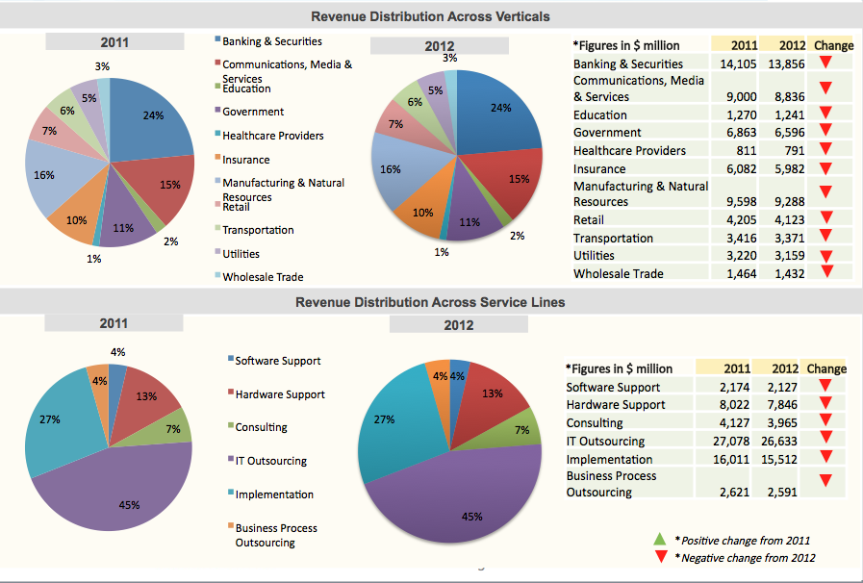
IBM Financials - Revenue Analysis
Notes:
5
Sources:
IBM Annual Report 2009
Gartner Market Share: IT Services, 2010 (2011)

Slide 6
Contract Analysis: Contracts Expiring in 2013
Customer Name | Customer Sub Industry | Geographic Scope Region | Engagement Type | Contract Value (Base) (in USD)
ISH Tecnologia S/A. (ISH Tecnologia Ltda) | Computer Programming and Data Processing Services | Latin America | Systems Integration Engagement | 1,823,591
Center for Information Processing and Information Technology (Zentrum fur Informationsverarbeitung und Informationstechnik - ZIVIT) | Computer Programming and Data Processing Services | Western Europe | Deploy and Support Engagement | 3,077,235
PCCW Solutions Limited | Computer Programming and Data Processing Services | Asia Pacific excluding Japan (APEJ) | Systems Integration Engagement | 206,124
Arek Oy | Computer Programming and Data Processing Services | Western Europe | IT Outsourcing Engagement | 6,038,812
Darmstadt data center DARZ (Darmstadter Rechenzentrum) | Computer Programming and Data Processing Services | Western Europe | Systems Integration Engagement | 17,261,220
Panasonic Corporation | High Tech: Equipment | Latin America, Asia Pacific excluding Japan (APEJ), Japan, Middle East & Africa, Central & Eastern Europe, Western Europe, North America | Other Outsourcing Services Engagement | 66,844,916
Google Latin America | Computer Programming and Data Processing Services | Latin America | Business Outsourcing Engagement | 1,568,000
Finanz Informatik | Computer Programming and Data Processing Services | Western Europe | IT Outsourcing Engagement | 299,260,000
Panasonic Europe Ltd. | High Tech: Equipment | Central & Eastern Europe, Western Europe | IT Outsourcing Engagement | 37,407,500
Healy Hudson GmbH | Computer Programming and Data Processing Services | Western Europe | IT Outsourcing Engagement | 7,481,500
Panasonic Corporation of North America (PNA) | High Tech: Equipment | North America | IT Outsourcing Engagement | 55,000,000
Notes:
Sources:
IDC Contracts Database

Slide 7
Contract Analysis: Contracts Expiring in 2013
Customer Name | Customer Sub Industry | Geographic Scope Region | Engagement Type | Contract Value (Base) (in USD)
Juniper Networks, Inc. | High Tech: Equipment | Latin America, Asia Pacific excluding Japan (APEJ), Japan, Middle East & Africa, Central & Eastern Europe, Western Europe, North America | IT Outsourcing Engagement | 56,000,000
Ericsson (Telefonaktiebolaget LM Ericsson) | High Tech: Equipment | Latin America, Asia Pacific excluding Japan (APEJ), Japan, Middle East & Africa, Central & Eastern Europe, Western Europe, North America | IT Outsourcing Engagement | 287,300,000
Endorsia International AB | Computer Programming and Data Processing Services | Western Europe | IT Outsourcing Engagement | 4,541,950
Endorsia International AB | Computer Programming and Data Processing Services | Western Europe | IT Outsourcing Engagement | 10,479,070
Airbus S.A.S. | Aerospace and Defense | Western Europe | Systems Integration Engagement | 44,774,000
ALNO A.G | Consumer Products (Discrete) | Western Europe | IT Outsourcing Engagement | 17,702,640
European Aeronautic Defense and Space Company N.V. (EADS) | Aerospace and Defense | Western Europe | Deploy and Support Engagement | 21,685,734
Rheinmetall AG | Aerospace and Defense | Western Europe | Business Outsourcing Engagement | 15,498,599
ABB Ltd. | High Tech: Other | Asia Pacific excluding Japan (APEJ), Middle East & Africa, Central & Eastern Europe, Western Europe, North America | IT Outsourcing Engagement | 1,700,000,000
Notes:
Sources:
IDC Contracts Database

Slide 8
Contract Analysis: Contracts Expiring in 2012
Customer Name | Customer Sub Industry | Geographic Scope Region | Engagement Type | Contract Value (Base) (in USD)
Sogeti (ST) | Computer Programming and Data Processing Services | Western Europe | Deploy and Support Engagement | 450,000
DB Systel GmbH | Computer Programming and Data Processing Services | Central & Eastern Europe, Western Europe | IT Outsourcing Engagement | 21,459,228
Spirit AeroSystems Holdings, Inc. | Aerospace and Defense | Asia Pacific excluding Japan (APEJ), Central & Eastern Europe, Western Europe, North America | IT Outsourcing Engagement | 4,000,000
Consip S.p.A | Computer Programming and Data Processing Services | Western Europe | Systems Integration Engagement | 66,656,732
Total System Services, Inc. (TSYS) | Computer Programming and Data Processing Services | Latin America | IT Outsourcing Engagement | 18,000,000
Eureka Forbes Limited | Consumer Products (Discrete) | Asia Pacific excluding Japan (APEJ) | IT Outsourcing Engagement | 15,000,000
InSiteOne, Inc. | Computer Programming and Data Processing Services | North America | IT Outsourcing Engagement | 15,000,000
Rheinmetall AG | Aerospace and Defense | Western Europe | IT Outsourcing Engagement | 190,524,000
Sony Mobile Communications AB | High Tech: Equipment | Latin America, Asia Pacific excluding Japan (APEJ), Japan, Middle East & Africa, Central & Eastern Europe, Western Europe, North America | IT Outsourcing Engagement | 17,864,700
Whirlpool Corporation | Consumer Products (Discrete) | Latin America, Asia Pacific excluding Japan (APEJ), Japan, Middle East & Africa, Central & Eastern Europe, Western Europe, North America | IT Outsourcing Engagement | 350,000,000
Honeywell International, Inc. | High Tech: Other | North America | Business Outsourcing Engagement | 250,000,000
Notes:
Sources:
IDC Contracts Database

Slide 9
Contract Analysis
List of all IBM Hi- Tech Contracts till date
Notes:
Sources:
IDC Contracts Database

Slide 10
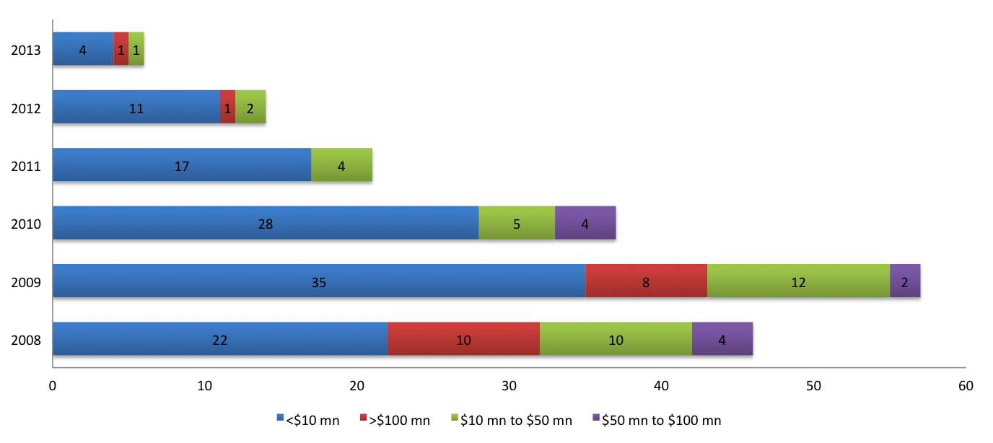
Contract Analysis: Year wise Deal distribution
In last few years the number of contracts has decreased . In 2008 and 2009 highest number of high valued deals were signed.
Deals signed only in the period of 2008-2013 and found in IDC Contract Database were considered for the Analysis
Notes:
Sources:
IDC Contracts Database

Slide 11
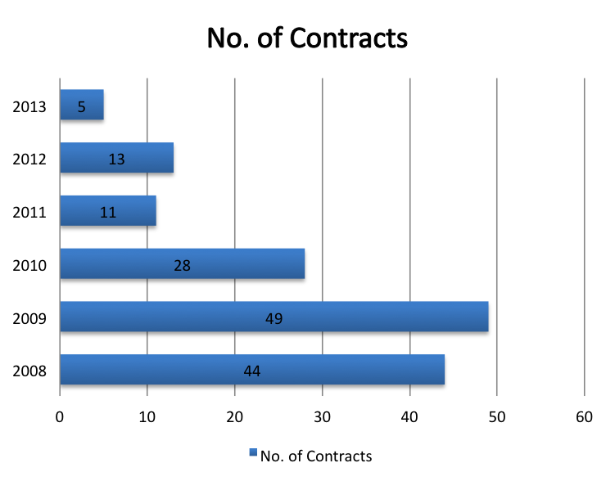
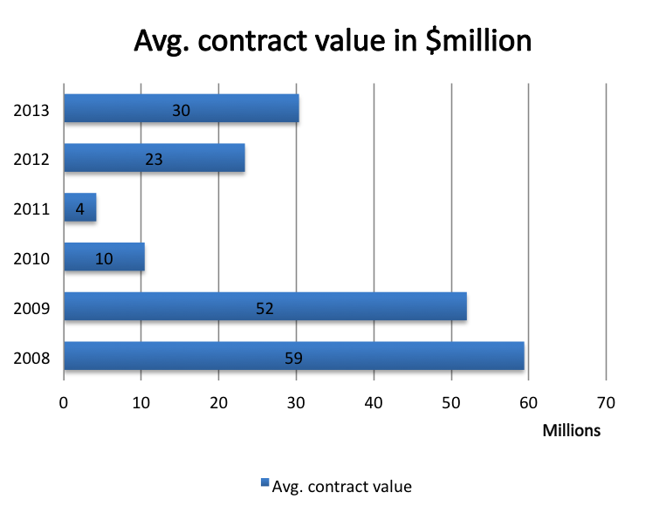
Contract Analysis: Year wise Deal distribution contd..
Highest number of deals have been signed in 2009
Deals signed in 2008 has the highest average contract value.
The costliest in the period (2008-2013) was signed in 2009 . The deal worth $ 850 million was signed by Equifax for 10 years
Deals signed only in the period of 2008-2013 and found in IDC Contract Database were considered for the Analysis
Notes:
Sources:
IDC Contracts Database

Slide 12
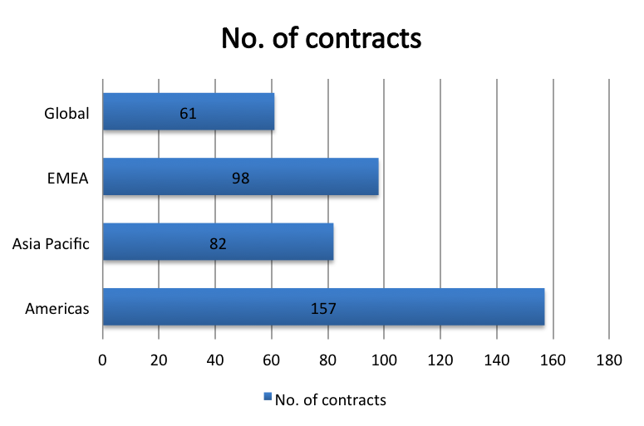
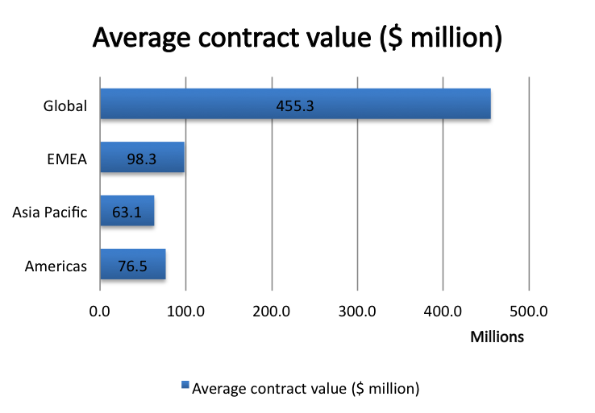
Contract Analysis: Geography wise Deal distribution
Highest number of deals have been signed for Americas
Deals with the Global geographic scope have highest Contract value
Deals with the geographic scope of Asia Pacific have lowest Contract value
Deals signed only in the period of 2008-2013 and found in IDC Contract Database were considered for the Analysis
Notes:
Sources:
IDC Contracts Database

Slide 13
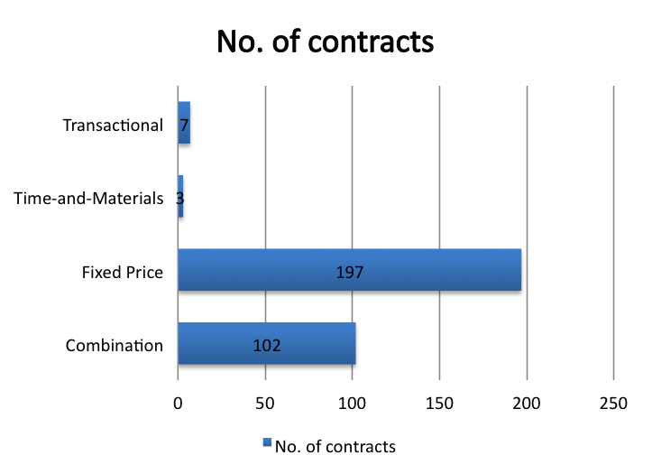
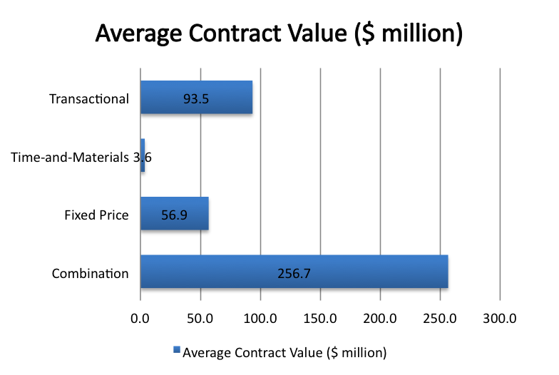
Contract Analysis: Pricing Methodology wise Deal distribution
Fixed Price is the most used pricing practice for IBM Hi Tech
Combinational Pricing ,which are used only in 33% contracts, carries around 50% of total contracts value.
Deals signed only in the period of 2008-2013 and found in IDC Contract Database were considered for the Analysis
Notes:
Sources:
IDC Contracts Database

Slide 14
Hi Tech Offerings- Service Offerings by Industry Sub segment
Sub Segments | Offerings
Electronics Industry solutions | Product lifecycle management solutions Global supply chain solutions Manufacturing execution systems solutions | Marketing, sales & service transformation solutions IBM software for a smarter electronics industry
Semiconductors Solutions | Custom logic Customer Processors Extended Ecosystem Specialty Foundry | Design services Data preparation and release Mask build 200 mm and 300 mm wafer manufacturing Wafer test Post wafer manufacturing Packaging Module test Pack and ship
Software Services and Solutions | Information Management Services Lotus Services Rational Services | Tivoli Services WebSphere Services PLM Software Services
Storage Solutions | Disk storage systems and NAS Tape storage systems and Media Virtual tape storage systems Storage management software | Storage technology topics Storage efficiency Data protection and retention Services, support and training
Server and Systems Solutions | Integrated Solutions Deep Computing Virtualization | Cloud Smarter Computing
Notes:
http://www-01.ibm.com/software/sw-services/?cm_re=masthead-_-itservices-_-software
http://www-935.ibm.com/services/us/gbs/industries/electronics/
http://www-03.ibm.com/technology/
http://www-03.ibm.com/systems/storage/index.html
.http://www-03.ibm.com/systems/?cm_re=masthead-_-products-_-sys-allsystems

Slide 15
IBM: Semiconductor research initiatives
Initiatives
Mar, 2013 - IBM announced a materials science breakthrough at the atomic level that could pave the way for a new class of non-volatile memory and logic chips that would use less power than today’s silicon based devices.
Oct, 2012 - IBM scientists have demonstrated a new approach to carbon nanotechnology that opens up the path for commercial fabrication of dramatically smaller, faster and more powerful computer chips.
IBM announced its next generation supercomputing project, Blue Gene/Q, will provide an ultra-scale technical computing platform to solve the most challenging problems facing engineers and scientists at faster, more energy efficient, and more reliable rates than ever before.
In 2010, IBM's Almaden Research Centre in USA is working with AZ Electronic Materials (AZ) on the development of materials based on block copolymers aimed at Directed Self-Assembly (DSA) processes. DSA technology is a potential bottoms-up lithography process meant to meet 16nm and 11nm half-pitch design requirements.
In 2010, Fab tool vendor Novellus Systems formed a joint development program with IBM in the 3-D chip arena. The companies plan to devise a copper-based, 3-D process, based on through-silicon via (TSV) technology. The process would use Novellus' Sabre copper electroplating and Vector plasma-enhanced chemical vapor deposition (PECVD) systems.
In 2009, IBM Corp., Applied Materials, Inc. and College of Nanoscale Science and Engineering of the University at Albany formed an agreement to jointly develop process modeling technology for manufacturing 22 nanometer (nm) logic and memory chips. The project will combine IBM’s semiconductor technology R&D leadership and computer modeling expertise with Applied’s semiconductor processing knowledge to develop predictive models that can help minimize process variation, reduce development cost, and improve time to market for 22nm products.
Notes:
Sources:
Datamonitor Company Profile – Wipro Technologies
OneSource

Slide 16
Hi Tech Focus
Strategic Focus | IBM has charted out enhanced strategy to help clients maximize benefits of virtualization with integrated service management by focusing on four key priorities: consolidation, management, automation and optimized delivery. This strategy is based on a comprehensive view of data center virtualization including servers, storage, networking, software and services.
Segmental Focus | IBM continues to focus on electronics industry offering design help, production management and other services to electronics companies and to manufacturers looking to outsource the creation of advanced electronics for their products. In 2002, a separate business unit was set up offering electronics industry solutions. IBM has focus on latest innovation across semiconductor industry with IBM Semiconductor Research & Development centre. IBM carries out semiconductor research at multiple locations across the world in collaboration with many companies in the industry like Toshiba, Sony, Hitachi, etc. and has been successful in coming out with breakthrough findings like 32nm bulk CMOS process technology development.
Geography Focus | Majority of hitech business for IBM comes from North America, Western Europe and Japan.
Notes:
Sources:
Annual Report
http://findarticles.com/p/articles/mi_pwwi/is_200712/ai_n21160943/
http://www.business-standard.com/india/news/ibm-to-increase-research-in-semiconductors-space/308803

Slide 17
Hi Tech Focus- Technology Competency
Diverse HiTech Offerings | IBM possesses largest scale and most diverse global offerings of all competitors. Key sub industry verticals include automotive, aerospace, high technology/electronics, industrial equipment, consumer goods; pharmaceutical/life sciences, mill products, chemicals and petroleum processing.
Strong in PLM | IBM is major power in PLM market, given its sheer size, influence, PLM experience, scope of software it provides, and breadth of partnerships managed.
Strong R&D | IBM has the advantage of market insight from synergy with its software business units and a reputation for making significant R&D investments in the IT industry at large. IBM has one of the most-developed vertical-industry marketing approaches, possessing wide industry specific domain expertise and relevant customer segmentation spanning manufacturing industries.
Notes:
17
Sources:
Gartner Report: A Guide to Choosing PLM Service Providers
Gartner Research Report: Competitive Landscape: IT Services Providers in Manufacturing Industries, 2009
http://findarticles.com/p/articles/mi_pwwi/is_200712/ai_n21160943/
http://www.business-standard.com/india/news/ibm-to-increase-research-in-semiconductors-space/308803/

Slide 18
Hi Tech Focus- Technology Competency
Technology
IBM
TCS
Leader in the Gartner’s Magic Quadrant for SAP application outsourcing
Size, longevity and scale of operations makes IBM leader in SAP outsourcing.
main SAP application life cycle services markets are the U.K., Germany, France, Italy and Spain
Challenger in the Gartner’s Magic quadrant for SAP application outsourcing.
First Indian provider to become a global SAP services partner
Leading offshore firm in the SAP services market.
Main SAP application life cycle services markets are U.K., Netherlands, Germany, Belgium and Finland
SAP
(Application Outsourcing)
Leader in the Gartner’s Magic Quadrant
IBM has broad set experience and capabilities across the entire Oracle Applications product portfolio
Challengers in the Gartner’s Magic Quadrant
Need to continue focus on driving innovations to truly deliver value.
Faces challenges in account management to deliver the broad range of capabilities that it possesses
Oracle
CRM
(Consulting & Solution implementation)
Leader in the Gartner’s Magic Quadrant for Consulting and Solution implementation.
Challenger in the Gartner’s Magic Quadrant for Consulting and Solution implementation.
Leader in the Gartner’s Magic Quadrant
Industry and domain expertise to deliver a compelling information led solution for BI and analytics engagements
Strength in IM areas and growing importance in information analysis
But capabilities in PM have still to catch up in prominence to its full solutions breadth
Challenger in the Gartner’s Magic Quadrant
clients rate it high for integrating BI solutions with enterprise application needs, and they indicate satisfaction with its ability to both scale resources for large engagements and effectively deliver at a competitive price
Needs to expand its PM offerings and invest in management consulting
BIPM
Notes:
18
Sources:
Gartner Magic Quadrant for CRM Service Providers, North America, May 2009
Gartner Magic Quadrant for Global Business Intelligence and
Performance Management Service Providers, January 2011
Magic Quadrant for SAP Application Service Providers, Europe (Published: 14 December 2011)
Magic Quadrant for Oracle Applications Service Providers, Europe (Published: 28 December 2011)
Magic Quadrant for Business Intelligence Platforms (Published: 6 February 2012)

Slide 19
HiTech Focus- Strategic Differentiators
R&D | Strong R&D skills and established innovation centers for electronics industry and semi-conductors.
Strong High Tech Brand | IBM is considered a thought leader and premium brand in providing IT services to high tech industry; as a result of significant resources it brings to the industry and to its marketing programs as the top IT consulting provider in the world.
ERP | Strong ERP practice with pioneering remote delivery capability.
Strong Clientele | Proven track record in large engagements for global customers. Ramp up capability and speed in execution.
Notes:
19
Sources:
Gartner Research Report: Competitive Landscape: IT Services Providers in Manufacturing Industries, 2009
Magic Quadrant for ERP Service Providers, Europe, 2007, Gartner
Datamonitor

Slide 20
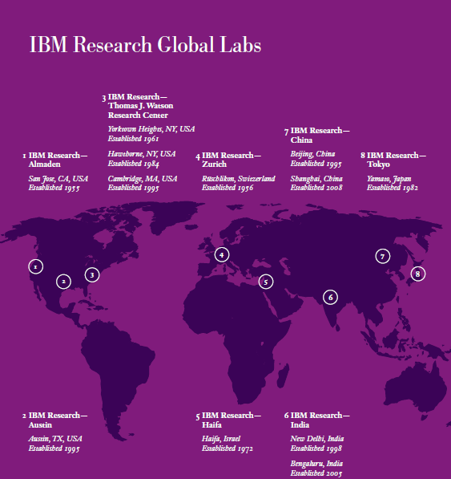
Hi Tech Focus: IBM Research
IBM set a new U.S. patent record in 2012, marking the 20th consecutive year that the company has led the annual list of patent recipients. IBM inventors earned a record 6,478 U.S. patents in 2012. The company's 2012 patent count exceeded the combined totals of Accenture, Amazon, Apple, EMC, HP, Intel, Oracle/SUN and Symantec.
Mar, 2013 -- IBM announced a materials science breakthrough at the atomic level that could pave the way for a new class of non-volatile memory and logic chips that would use less power than today’s silicon based devices.
Oct, 2012- IBM scientists have demonstrated a new approach to carbon nanotechnology that opens up the path for commercial fabrication of dramatically smaller, faster and more powerful computer chips.
Notes:
http://www-03.ibm.com/technology/leadership/
http://www-03.ibm.com/press/us/en/pressrelease/

Slide 21
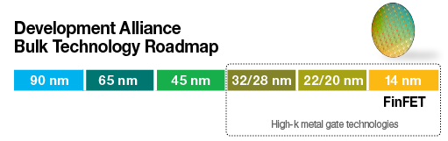
Hi Tech Focus: IBM Semiconductor Research- Thought Leadership
IBM and a strategic alliance of semiconductor manufacturing, development and technology companies continue working together to overcome semiconductor design and process technology development challenges that become more complex as technology nodes shrink
Bulk offerings in 32/28 nm and previous technology nodes are already in volume production, and 22 nm/20 nm technology development work is nearing completion. Joint, dedicated resources are now focused on development of bulk-based FinFET technology in the 14 nm node.
The Technology Development Alliance of semiconductor leaders IBM, GLOBALFOUNDRIES, Samsung Electronics Co. and STMicroelectronics has successfully delivered multiple generations of advanced process technologies, including the breakthrough high-k metal gate (HKMG) solution
Leading-edge R&D work continues at Albany Nanotech and the IBM Semiconductor R&D Center, tapping into pioneering advances to help bring a faster, smaller, more cost-efficient and power-efficient generation of semiconductors to the marketplace.
The Common Platform alliance, a collaboration of IBM, Samsung Electronics Co. and GLOBALFOUNDRIES, was formed to help solve today’s complex chip-design and manufacturing challenges. Synchronized fabrication capabilities at globally dispersed facilities offer manufacturing choice and flexibility.
Leading EDA, design services, IP, packaging and test providers work closely with IBM and companies from both alliances to seamlessly develop and optimize semiconductor solutions that complement alliance silicon offerings.
Notes:
http://www-03.ibm.com/technology/leadership/

Slide 22
Recent Acquisitions
StoredIQ | StoredIQ will advance IBM’s efforts to help clients derive value from big data and respond more efficiently to litigation and regulations, dispose of information that has outlived its purpose and lower data storage costs
Texas Memory Systems | IBM announced it has entered into a definitive agreement to acquire Texas Memory Systems (TMS), a leading developer of high-performance flash memory solutions
Kenexa | IBM and Kenexa Corporation announced they have entered into a definitive agreement for IBM to acquire Kenexa, a publicly held company headquartered in Wayne, Pa., in a cash transaction at a price of $46 per share, or at a net price of approximately $1.3 billion.
Green Hat | Green Hat is a leader in software quality and testing solutions for the cloud and other environments. When combined with IBM’s Rational software solutions, developers and testers can achieve unprecedented levels of efficiency, effectiveness and collaboration while delivering quality software to their business.
Emptoris | Emptoris' spend management solutions complement the existing B2B integration and supply chain management capabilities IBM acquired through the purchase of Sterling Commerce in 2010. The Emptoris acquisition will allow IBM to deliver more solutions focused on the needs of sourcing and procurement professionals.
Q1 Labs | IBM acquired Q1 Labs, which provides advanced analytics to detect and flag suspicious or abnormal events. Q1 Labs' advanced analytics and correlation capabilities can help detect and flag actions that deviate from prescribed policies and typical behavior with a view across an organization's network, applications, user activity, mobile endpoints, and physical security devices — including both cloud-based and on-premise sources. Q1 Labs will join the newly formed Security Systems division, which integrates IBM's Tivoli, Rational and Information Management security software, appliances, lab offerings and services.
Notes:
22
Sources:
Company Website
Onesource
http://en.wikipedia.org/wiki/List_of_mergers_and_acquisitions_by_IBM
http://www.spendmatters.com/index.cfm/2011/12/15/First-Take-IBM-Acquires-Emptoris

Slide 23
Recent Acquisitions
Algorithmics | The acquisition expands IBM's business analytics capabilities in the area of financial risk. Algorithmics provides software and services for improved business insights at banks and investment and insurance organizations to assess risk and address regulatory challenges. The purchase price is $380.2 million.
i2 | i2 expands IBM's big data analytics software for smarter cities by helping both public and private entities in government, law enforcement, retail, insurance and other industries access and analyze information they need to combat crime, fraud and other security threats. Craig Hayman, general manager, IBM Industry Solutions said "Through our acquisition of i2, we are strengthening our ability to help cities, countries, international organizations and private enterprises create safer environments for conducting business."
Worklight | With this acquisition, IBM's mobile offerings will span mobile application development, integration, security and management. Worklight will become an important piece of IBM's mobility strategy, offering clients an open platform that helps speed the delivery of existing and new mobile applications to multiple devices. It also helps enable secure connections between smartphone and tablet applications with enterprise IT systems.
Demand Tec | The acquisition further extends IBM's Smarter Commerce initiative by adding cloud-based software to help companies drive profitability through measurable pricing, promotion, and assortment planning.
Notes:
23
Sources:
Company Website
Onesource
http://en.wikipedia.org/wiki/List_of_mergers_and_acquisitions_by_IBM
http://www.spendmatters.com/index.cfm/2011/12/15/First-Take-IBM-Acquires-Emptoris

Slide 24
Alliances- New
Open Virtualization Alliance | BMC Software, Eucalyptus Systems, HP, IBM, Intel, Red Hat Inc. and SUSE formed the Open Virtualization Alliance, a consortium committed to fostering the adoption of open virtualization technologies including Kernel-based Virtual Machine (KVM). The consortium will promote examples of customer successes, encourage interoperability and accelerate the expansion of the ecosystem of third party solutions around KVM, providing businesses improved choice, performance and price for virtualization.
Samsung | jointly develop new semiconductor process technology through the Semiconductor Research Alliance at the Albany Nanotech Complex, Albany, NY.
Novellus Systems | Novellus Systems has formed a joint development program with IBM in the 3-D chip arena., to devise a copper-based, 3-D process, based on through-silicon via (TSV) technology. (Mar 2010)
Broadridge Financial Solutions | Broadridge Financial Solutions, Inc. and IBM formed an IT services agreement whereby IBM will provide Broadridge data center and information processing services. In addition to the IT services agreement, Broadridge and IBM have signed a business alliance agreement.
Chartered Semiconductor | Chartered process offering, jointly developed with IBM Corporation, is based on Chartered's enhanced 65nm low-power process (65nm LPe), and includes an IBM RF physical design kit (PDK) available from Chartered
Qwest Comm. International | Qwest Communications International Inc. and IBM Corporation announced a five year agreement to deliver highly proactive managed services to mid-size businesses.
Notes:
24
Sources:
Company Website
Onesource
http://en.wikipedia.org/wiki/List_of_mergers_and_acquisitions_by_IBM
http://www.spendmatters.com/index.cfm/2011/12/15/First-Take-IBM-Acquires-Emptoris

Slide 25
Alliances – Existing Key Alliances
Siemens | IBM and Siemens PLM Software announced offerings for firms to improve the management of products throughout their lifecycle from design and manufacturing to end-of-life planning and recycling and simplify the process of sharing key product data and manufacturing plans
Dassault Systemes | Leader in 3D and PLM solutions; Sales channel for IBM
Infosys | Expertise in enterprise content management, document management, workflow and web content management
CMS Software | Leading provider of enterprise resource planning software, manufacturing software and supply chain management software solutions to manufacturers and distributors operating in supply chain intensive environments
Coral8 | IBM formed this alliance in 2007 to enhance its RFID capabilities
Infor | IBM formed this alliance in 2007 to deliver end-to-end business solutions that address the needs of discrete manufacturers worldwide
Finnish Defense Forces | The alliance aimed at the formation of new industry framework for the defense industry
VAI | VAI joins IBM as a Service (SaaS) Specialty program to deliver cloud services to its clients
Notes:
25
Sources:
Coral8 Teams With IBM to Provide Integrated RFID Solutions, 9 August 2007, Business Wire
Infor and IBM Deliver Solutions for Mid-Sized Businesses ; IBM Renews Services Capabilities for Manufacturing Industry Solutions , 10 September 2007, Business Wire
IBM and Finnish Defense Forces Enlist SOA to Deliver the Future of Integrated Command and Control, 22 April 2008, Market Wire
VAI Joins IBM Software as a Service Specialty, 22 December 2008, Business Wire
Toshiba, IBM, and AMD Tout World's Smallest FinFET SRAM Cell with High-k/Metal Gate, 21 December 2008, Wireless News
Rohm and Haas and IBM Ink Development Deal, 20 December 2008, Wireless News
http://www-03.ibm.com/press/us/en/pressrelease/26240.wss
http://www-03.ibm.com/press/us/en/pressrelease/24994.wss
IBM AND SAMSUNG DEVELOP SOFTWARE RE-USE TECHNOLOGY, 11 December 2008, ComputerWire News

Slide 26
Alliances – Existing Key Alliances contd..
Toshiba | Toshiba Corp., IBM, and AMD developed a world’s smallest Static Random Access Memory (SRAM) cell that that makes use of fin-shaped Field Effect Transistors (FinFETs).
Rohm and Haas | This alliance was formed to IBM to develop, as well as evaluate, new materials for emerging packaging technologies. They would focus on the evaluation of photoresists and supporting ancillaries, and low-temperature photodielectric materials for IBM's 3D packaging technologies.
Harvard researchers | A world community grid has been launched to discover materials to develop low cost solar cells
CMS Software | State-of-the-art solution developed to facilitate and ease exchange of information between companies with the goal of submitting registration dossiers required by the REACH Regulation
Samsung | Alliance formed to develop technology for facilitating the re-use of embedded software in electronics devices.
Japan Airlines | IBM Japan, IBM Business Consulting Services, and SAP Japan Co collaborated on the JAL Mighty project to create a system to manage maintenance planning, quality control and parts inventory for approximately 160 aircraft, 460 engines and 500,000 parts.
Notes:
26
Sources:
Coral8 Teams With IBM to Provide Integrated RFID Solutions, 9 August 2007, Business Wire
Infor and IBM Deliver Solutions for Mid-Sized Businesses ; IBM Renews Services Capabilities for Manufacturing Industry Solutions , 10 September 2007, Business Wire
IBM and Finnish Defense Forces Enlist SOA to Deliver the Future of Integrated Command and Control, 22 April 2008, Market Wire
VAI Joins IBM Software as a Service Specialty, 22 December 2008, Business Wire
Toshiba, IBM, and AMD Tout World's Smallest FinFET SRAM Cell with High-k/Metal Gate, 21 December 2008, Wireless News
Rohm and Haas and IBM Ink Development Deal, 20 December 2008, Wireless News
http://www-03.ibm.com/press/us/en/pressrelease/26240.wss
http://www-03.ibm.com/press/us/en/pressrelease/24994.wss
IBM AND SAMSUNG DEVELOP SOFTWARE RE-USE TECHNOLOGY, 11 December 2008, ComputerWire News

Slide 27
Key Investments
2009
In August 2009, IBM opened an Analytics Solution Center in China as part of a network of centers offering advanced analytics capabilities. It will provide grid computing, supply chain management, city transportation and traffic management, and water management
2010
Very recently IBM and its Common Platform technology partners Chartered Semiconductor Manufacturing and Samsung Electronics, along with joint-development alliance partners Infineon Technologies AG and Freescale Semiconductor, signed a series of semiconductor process development and manufacturing agreements. The partners plan to pool their combined expertise and collaborate to design, develop and manufacture advanced technology through 2010
2011
IBM has completed acquisition of the following companies in the FY 2011-12 period Green Hat, Emptoris, DemandTec, Platform Computing, Q1 Labs, I2, TRIRIGA Inc
2013
IBM Global Business Services created a new consulting service line in July 2009, named Business Analytics and Optimization (BAO).
Opened its first European site in Romania for developing and testing IBM switch and networking hardware and software.
Joint technology development agreement and a patent license agreement with Crocus Technology . The patent license provides mutual access to patents that will enable the companies to collaborate and integrate magnetic technology into semiconductor products.
IBM Is investing USD 1 bln into the research and development of flash memory technology. The goal of the investment is to design, create and integrate new flash technologies into IBMĺs expanding portfolio of servers, data storage systems and middleware.
Notes:
27
Sources:
wiki
“IBM, Chartered, Samsung, Infineon and Freescale Expand Technology Agreements” ENP Newswire, May 2007
http://www-03.ibm.com/press/us/en/pressrelease/25486.wss
IBM to expand computer centre in Vienna, 25 November 2008, APA Economic News Service
Factiva News: IBM OPENS ANALYTICS CENTER IN CHINA
Gartner Magic Quadrant for Global Business Intelligence and Performance Management Service Providers

Slide 28
SWOT Analysis
Strengths
Weakness
Diversified solutions
Strong client list
Leaders in SCM consulting and integration service provider
Superior vertical reach
Strong R&D capabilities
Complexity and size of IBM affects agility
Weak enterprise mobility product portfolio
Opportunities
Threats
Growing demand for cloud services
Globalization of the processes in the high tech industry
Growing technology demand
Strategic Acquisition
Growth Market Focus
Intense Competition
Offshore consultancy

Slide 29
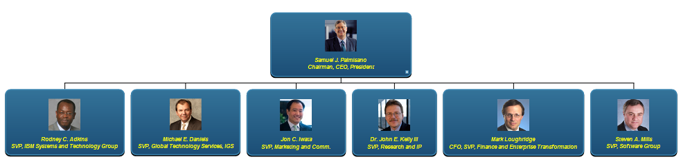

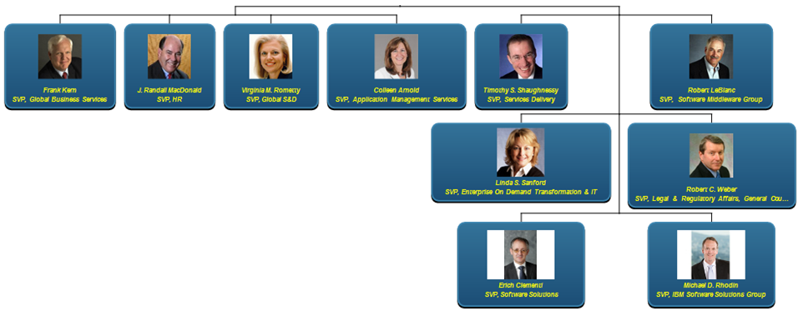

Key Executives
Ginni” Rometty
President and CEO
LYN belo
SVP S&D

Slide 30
Appendix

Slide 31
SWOT Analysis- Strentgh
Diversified High Tech solutions and offerings: IBM delivers High-Tech PLM solutions to help High-Tech and electronics companies in their strategic initiatives around the transformation of product development, manufacturing and enterprise collaboration processes by delivering solutions that integrate business process management with cutting-edge tools for design, engineering and manufacturing planning.
Enviable client list: With big names in the clients list like Honeywell, Solectron, Ericsson, Panasonic, Sony etc. in high tech industry sector, this helps the company attract more customers in this space.
Leaders in SCM consulting and integration service provider : IBM’s SCM practice has deep technology skills and broad industry experience. It covers SAP, Oracle, and specialized packages, as well as IBM integration software. Consultants and technologists draw upon a well-elaborated maturity model and IBM's internal SCM initiatives.
Superior vertical reach in high tech industry: IBM is ranked as the leading service provider in IT outsourcing, web hosting, consulting and systems integration. IBM is the clear leader in this space; with revenue almost double of that its nearest competitor. Innovation and acquisitions and leadership in the service oriented architecture (SOA) space will continue to give IBM an edge in terms of technology for the next two years. IBM will continue to lead in this vertical due to its superior vertical reach and continuous improvement of its technology.
Strong R&D capabilities provide a competitive advantage to the company: IBM has developed strong research, development and engineering capabilities, as it annually spends approximately $6 billion on R&D, focusing its investments on high-growth, high-value opportunities. Its investments in R&D also result in intellectual property (IP) income of approximately $1 billion annually. Its R&D investments in 2008 were in scientific research and the application of scientific advances to the development of new and improved products and their uses, as well as services and their application. Moreover, its R&D has enabled it to receive more US patents than any other company in 2008, for the 16th consecutive year.
Notes:
Annual Report

Slide 32
SWOT Analysis- Opportunities
Growing demand for cloud services: The worldwide demand for cloud computing services is forecast to record strong growth in coming years. Cloud computing infrastructure model enables delivery of software as a service (SaaS) and reduces the upfront royalty or licensing payments, investment in hardware and other operating expenses. As result of its benefits, the cloud services market is forecast to grow by over 20% in 2009 to cross a value of $55 billion. Growing demand for cloud services will facilitate IBM’s revenue and market share growth from the high tech sector in coming years.
Globalization of the processes in the high tech industry : High tech firms based in emerging markets, such as Eastern Europe and Asia/Pacific are exhibiting increasingly greater demand for IT services encompassing synchronizing global demand with back-end processes and the supply chain to standardize and streamline disparate regional processes into unified global process while addressing regional requirements. Manufacturers are utilizing IT services companies to help them rein in costs that could otherwise render them uncompetitive or irrelevant in the manufacturing industry.
Growing technology demand for growth in the high tech and manufacturing vertical: Gartner predicts that the high tech and manufacturing industries have more-technology plans, as external forces continue to shape the opportunity environment .Investments are likely to be made in CRM and PLM initiatives that would directly affect manufacturers' top-line results by delivering greater insight to manufacturers' segment expansion, service expansion or product portfolio management programs undertaken for tapping increased demand.
Strategic Acquisition: IBM has completed acquisition of the following companies in the FY 2011-12 period- Worklight, Green Hat, Emptoris, DemandTec, Platform Computing, Q1 Labs, I2, TRIRIGA Inc. Such acquisitions provide enough reach and opportunity for the company to increase its business to business marketing through the alliance network and channels. Since the beginning of 2000, IBM has acquired 130 companies in strategic areas including analytics, cloud, security and Smarter Commerce and expecting to spend $20 billion in acquisitions over the 2015 Road Map period to support growth initiatives.
Notes:
IBM Annual Report- 2011

Slide 33
SWOT Analysis- Weakness
Complexity and size of IBM affects agility: Slower to exploit opportunities from market changes. Some buyers in the market perceive a disconnection between GTS and GBS from an integrated service sales and delivery perspective. Moreover some clients like GM have stated that disconnected delivery teams resulting from heavily matrixed and varied delivery structure creates an inability to share best practices.
Weak enterprise mobility product portfolio: In the enterprise mobility market, IBM’s portfolio of solutions has few gaps. Absence of mobility devices keeps the company at a competitive disadvantage, when compared to its key competitors like Nokia and RIM with significant presence in this segment. On the other hand, it faces significant competition in the mobile middleware market from Sybase, Microsoft and other players offering similar solutions. IBM has strong presence in the enterprise mobility market but its weakness remains in service capabilities and service levels. IBM is striving to fill gaps in its portfolio, which would affect its near term prospects of the business.

Slide 34
SWOT Analysis- Threat
Intense Competition: IBM is facing intense competition from several large players. In the consulting and outsourcing market in high tech industry, it faces stiff competition from Accenture, Computer Sciences Corporation (CSC) and Hewlett Packard (HP). Further, it also competes with the Indian IT services companies, such as Infosys, Wipro and TCS. In the application infrastructure software business, IBM faces competition from Oracle, Sun Microsystems and Microsoft. While in the market for servers, IBM’s position is challenged by HP, Sun Microsystems and Dell.
Offshore consultancy: There has been a surge of Indian based technology consulting companies entering the US with a more consolidated base in India. Indian firms like Wipro, Infosys and TCS are benefiting from their unique cost proposition. Wipro and TCS have also acquired IBM’s market share in the consulting business due to their low cost India based operations. Also, the political debate over outsourcing in the US has led to many US states seeking legislation to block government contracts to companies that shift jobs offshore. Any regulation to curtail outsourcing may also have an adverse impact on IBM’s operations in North America.
Notes:
http://www.foxnews.com/politics/2011/08/04/us-debt-reaches-100-percent-countrys-gdp/
Ernst & Young: Eurozone Forecast Autumn edition (September 2011)

Slide 35
Thank You
Thank you for reading the report. Was the report useful to you? Do you need more research?
Please send your comments/suggestions to:
rohit5.j@tcs.com
aditi.royghatak@tcs.com
June 6, 2013

